Slide 1
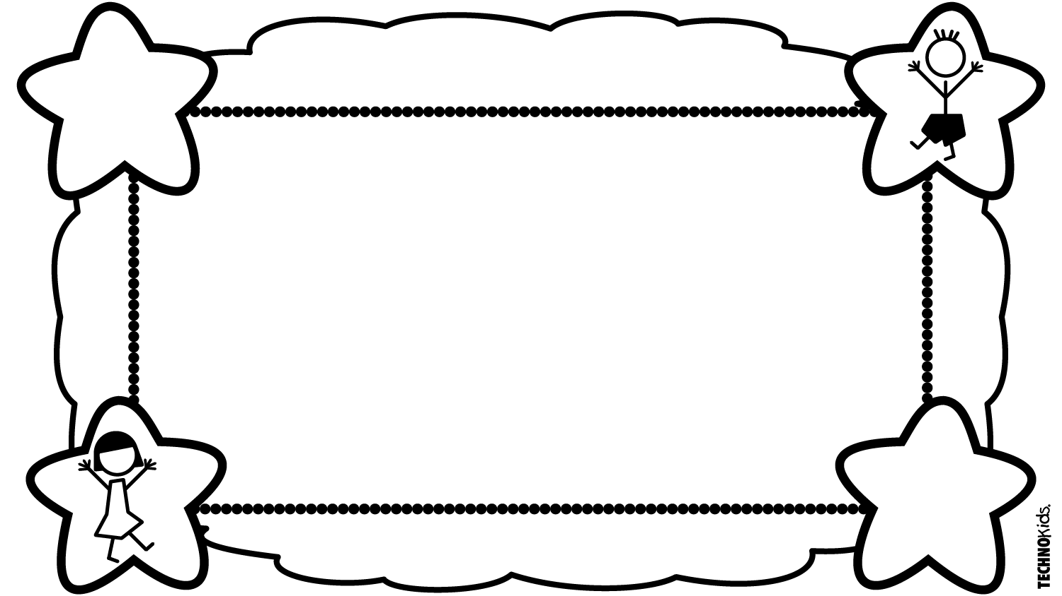
All About Me
By Me... Student

Slide 2
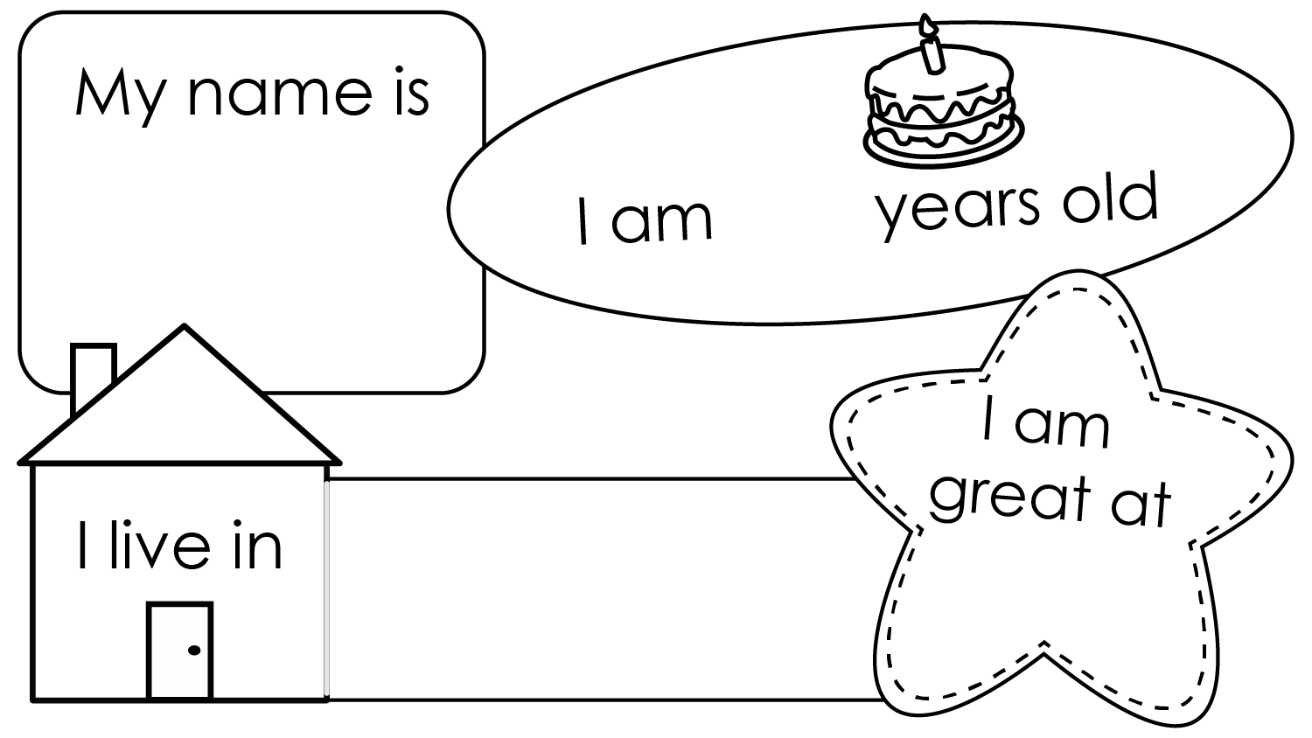
Student
#
City
activity

Slide 6
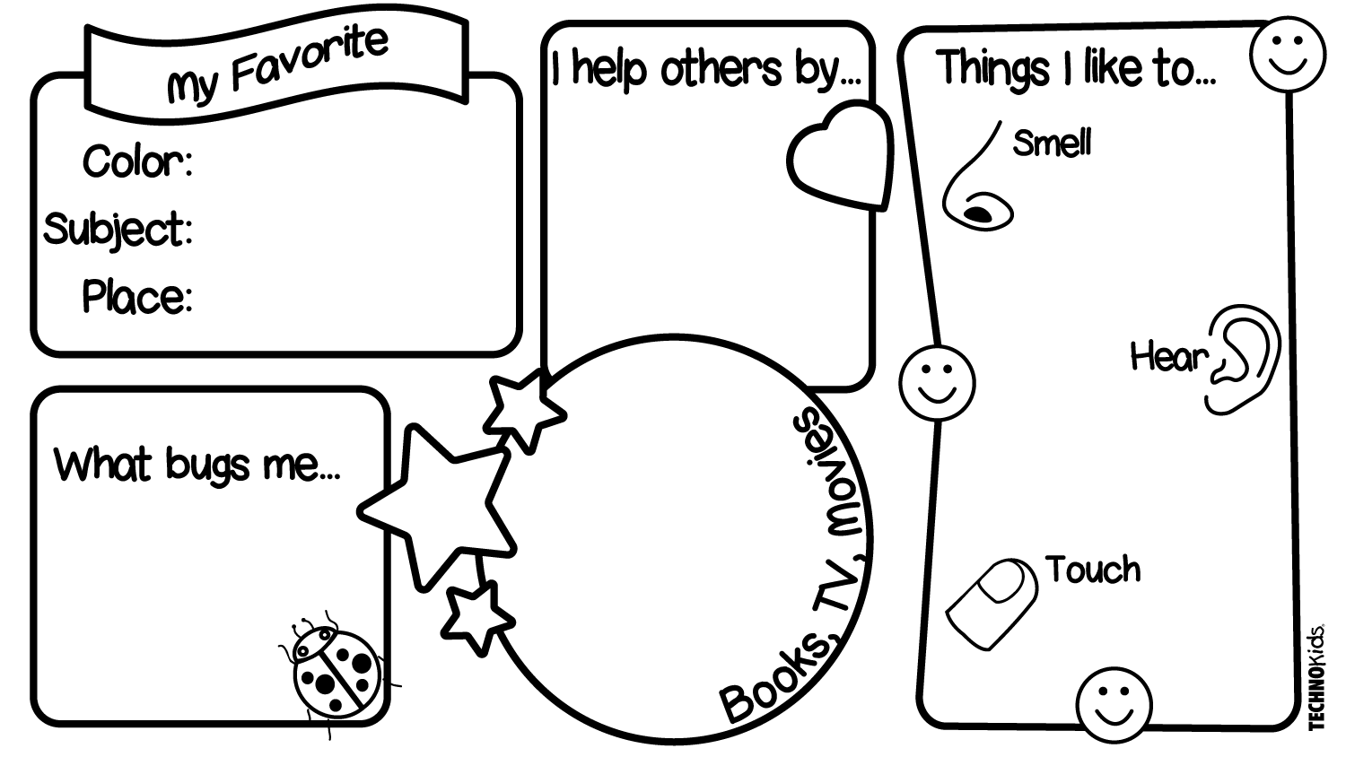
Type your answer here...
color
smell
subject
place
hear
What do you like to read or watch?
Type your answer here...
touch

