Slide 1
All About Me
By Me... Jake

Slide 2
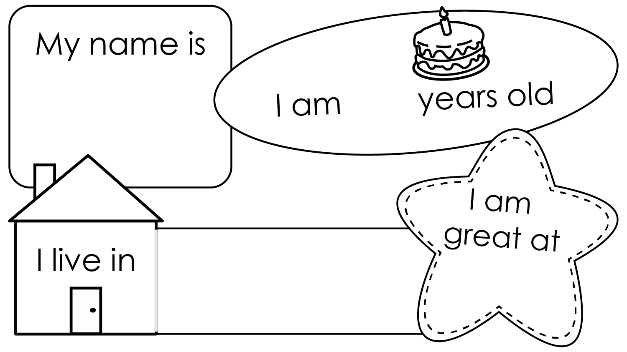
Jake
7
Hamilton
soccer

Slide 3
Fire Fighter

